Slide 1


Slide 2


Slide 3



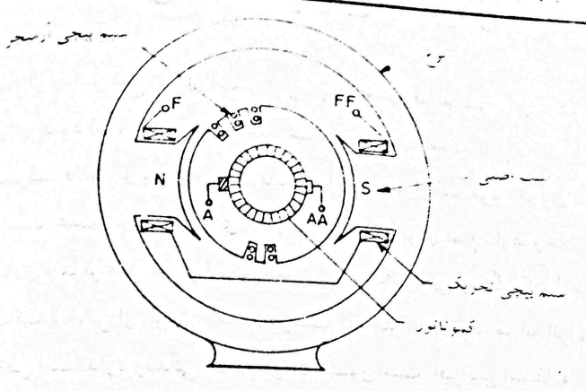

Slide 4

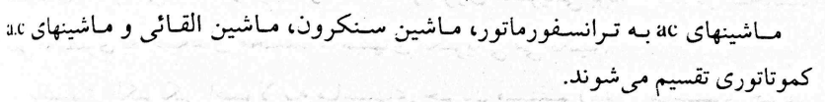

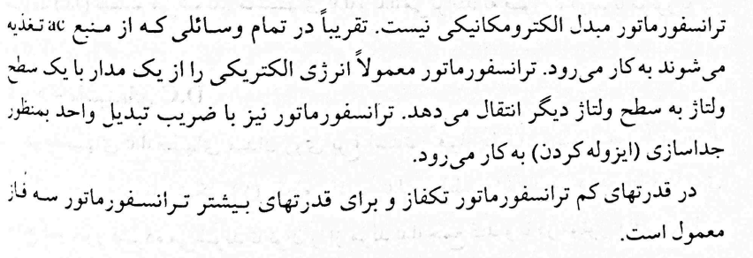

Slide 5
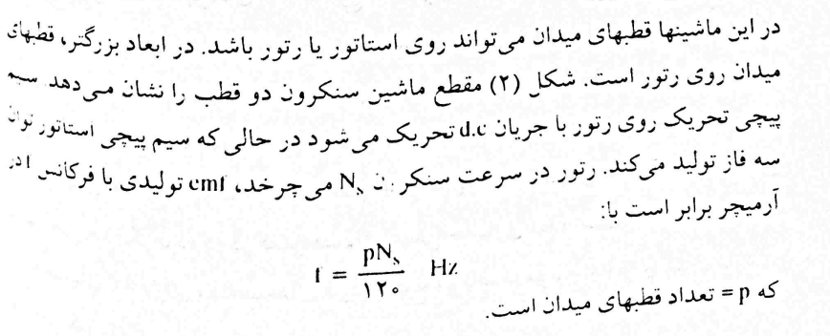

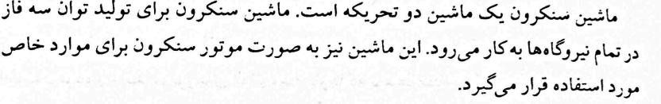
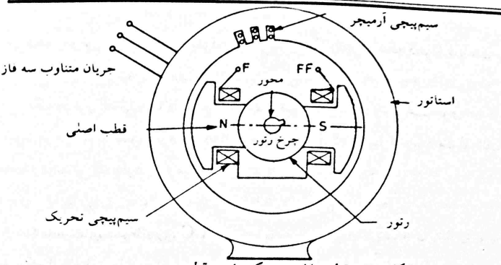

Slide 6



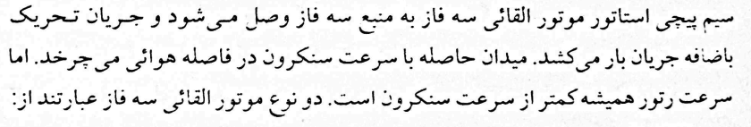

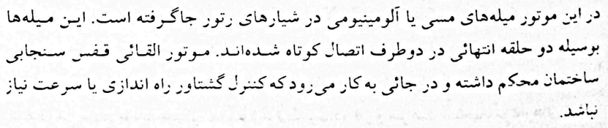

Slide 7

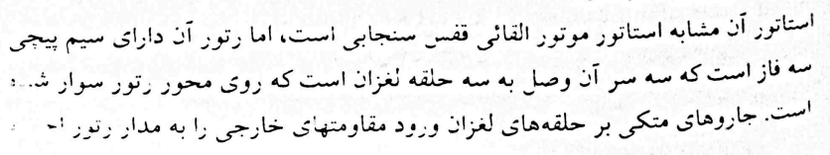
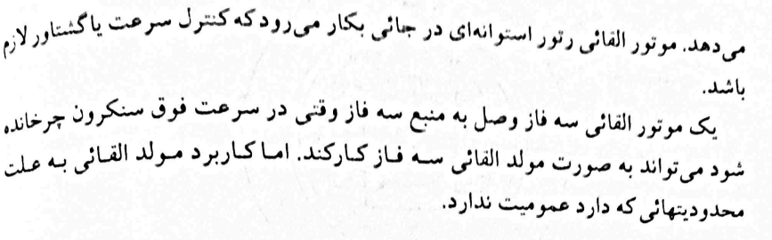

Slide 8

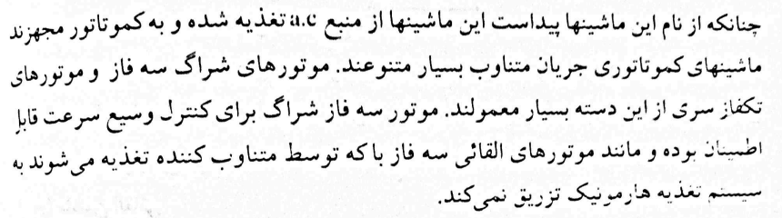

Slide 9

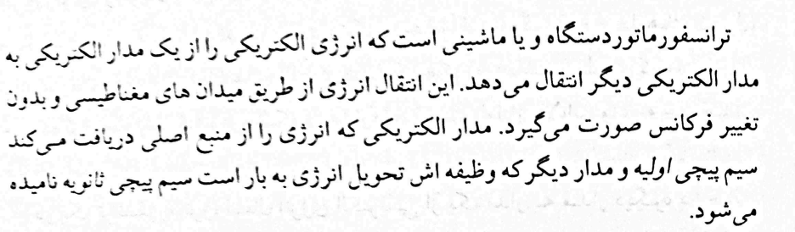

Slide 10
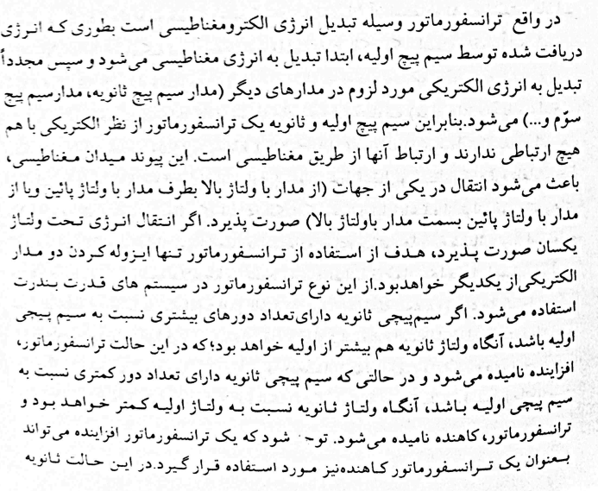

Slide 11
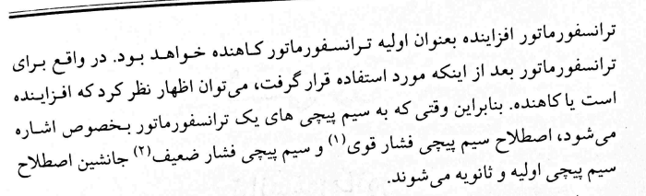
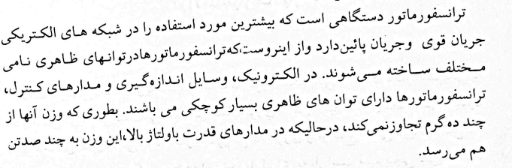

Slide 12
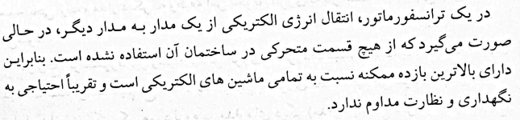
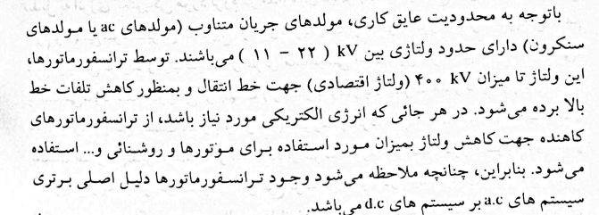

Slide 13
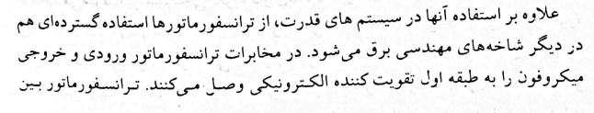
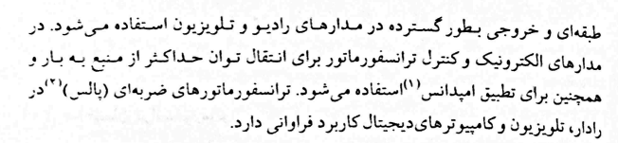

Slide 14
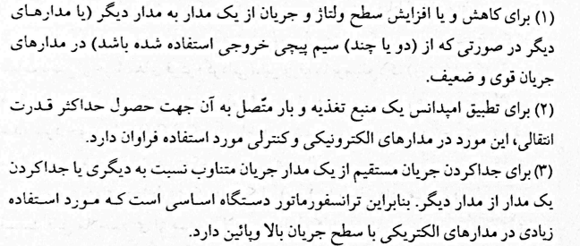

Slide 15
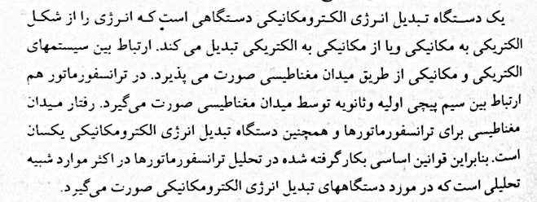
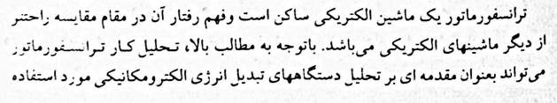


Slide 16

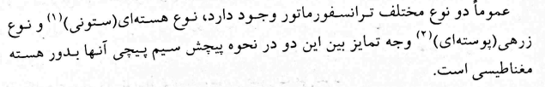
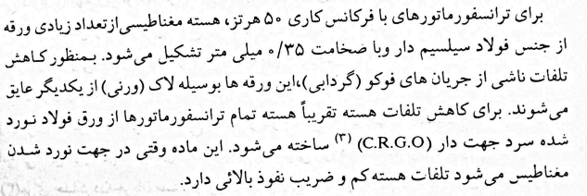

Slide 17
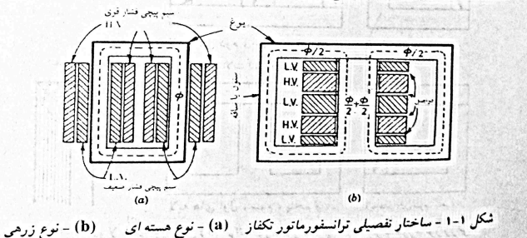
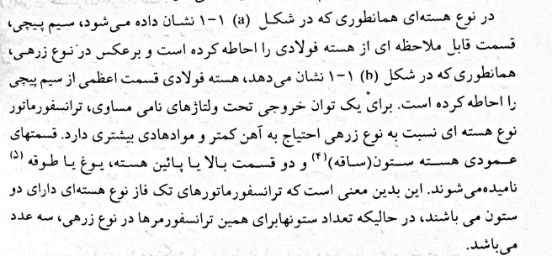

Slide 18

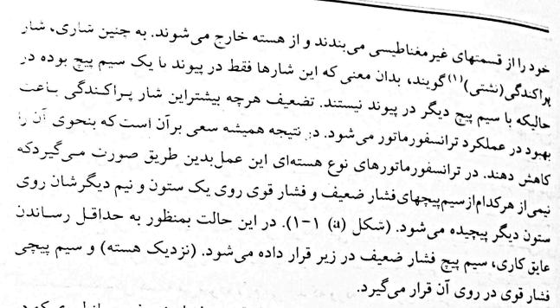

Slide 19
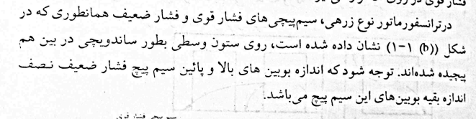
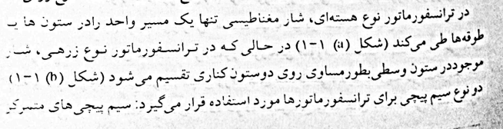

Slide 20
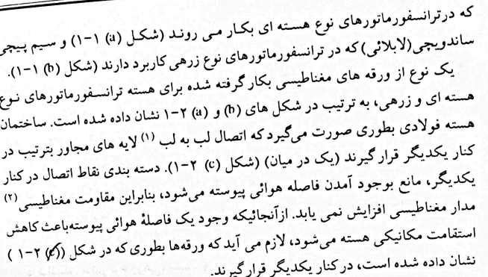

Slide 21
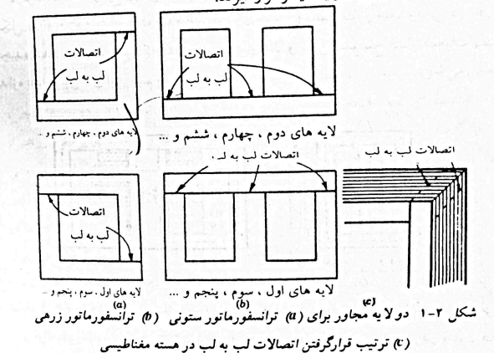

Slide 22
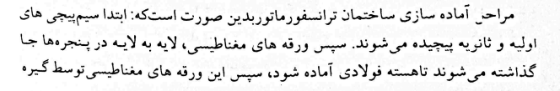
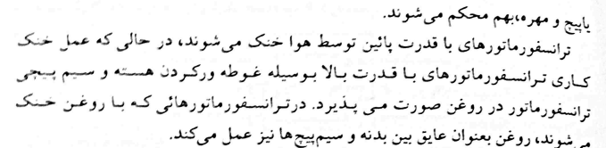

Slide 23
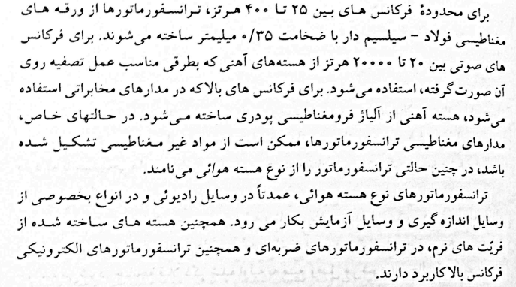

Slide 24

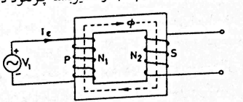





Slide 25
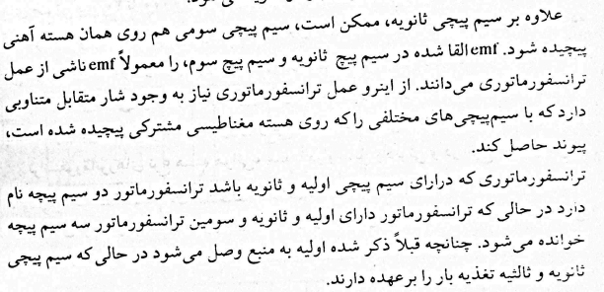

Slide 26

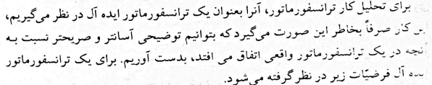
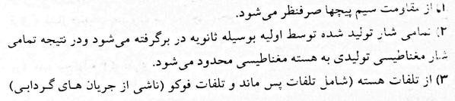
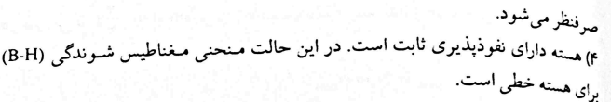

Slide 27
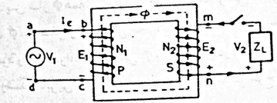
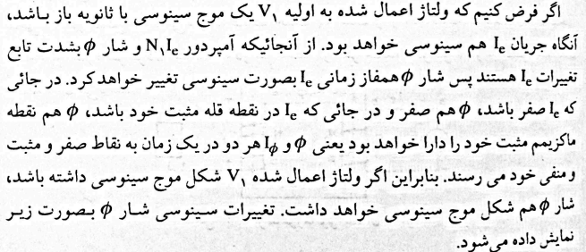

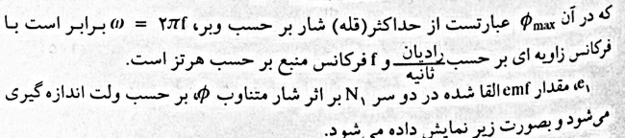
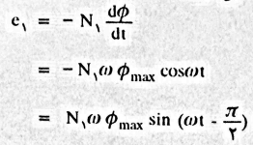

Slide 28

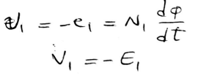
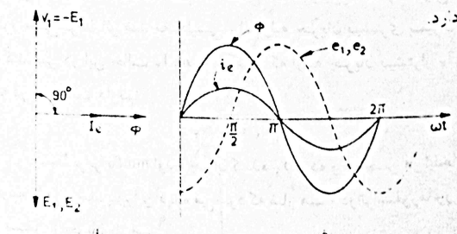
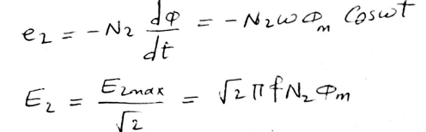
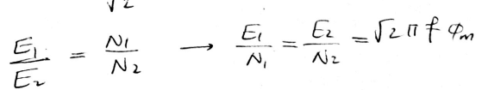

Slide 29
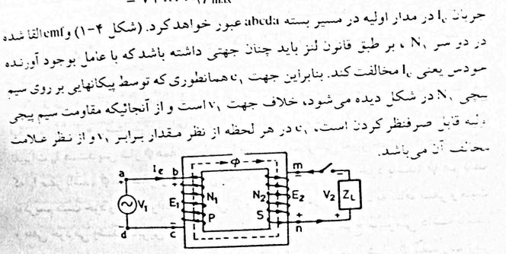

Slide 30
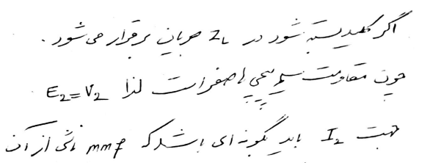

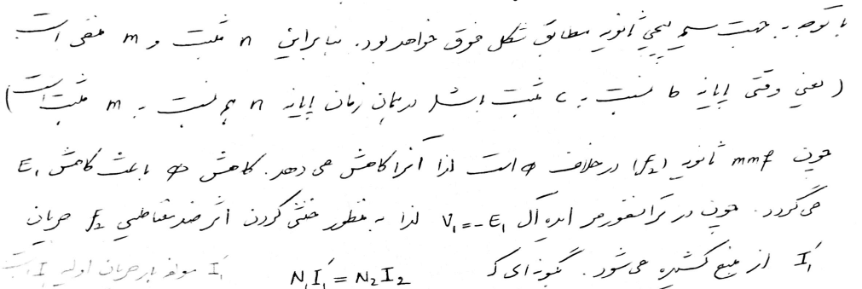

Slide 31





Slide 32



Slide 33







Slide 34








Slide 35





Slide 36




Slide 37






Slide 38




Slide 39





Slide 40





Slide 41






Slide 42



Slide 43




Slide 44



Slide 45



Slide 46



Slide 47



Slide 48



Slide 49





Slide 50




Slide 51





Slide 52



Slide 53



Slide 54








Slide 55






Slide 56


Slide 57







Slide 58





Slide 59





Slide 60




Slide 61





Slide 62





Slide 63






Slide 64



Slide 65








Slide 66







Slide 67




Slide 68








Slide 69





Slide 70







Slide 71




Slide 72






Slide 73










Slide 74



Slide 75


Slide 76



Slide 77






AC
Genertaor

Slide 78


Slide 79






Slide 80







Slide 81




Slide 82





Slide 83




Slide 84


Slide 85





Slide 86


Slide 87


Slide 88


Slide 89







Slide 90





Slide 91


Slide 92




Slide 93



Slide 94



Slide 95









Slide 96






Slide 97


Induction Motors

Slide 98













Slide 99








Slide 100






Slide 101





Slide 102




Slide 103





Slide 104






Slide 105






Slide 106





Slide 107


Slide 108




Slide 109





Slide 110










Slide 112





Slide 113










Slide 114










Slide 115








Slide 116












Slide 117



Slide 118







Slide 119



Slide 120



Slide 121




Slide 122





Slide 123







Slide 124






Slide 125


Slide 126



Slide 127


Slide 128





Slide 129


Slide 130






Slide 131









Slide 132





Slide 133


Slide 134





Slide 135




Slide 136







Slide 137




Slide 138



Slide 139











Slide 140


Slide 141







Slide 142









Slide 143




Slide 144


Slide 145





Slide 146





Slide 147





Slide 148


Slide 149



Slide 150






Slide 151




Slide 152




Slide 153


Slide 154


Slide 155


Slide 156


Slide 157




Slide 158


Slide 159


Slide 160


Slide 161





Slide 162



Slide 163


Slide 164



Slide 165


Slide 166


Slide 167





Slide 168







Slide 169









Slide 170






Slide 171





Slide 172



Slide 173






Slide 174




Slide 175


Slide 176




Slide 177




Slide 178



Slide 179





Slide 180



Slide 181



Slide 182




Slide 183


Slide 184



Slide 185


Slide 186


Slide 187



Slide 188



Slide 189





Slide 190







Slide 191




Slide 192



Slide 193




Slide 194



Slide 195




Slide 196




Slide 197



Slide 198



Slide 199


Slide 200



Slide 201


Slide 202



Slide 203



Slide 204


Slide 205


Slide 206


Slide 207


Slide 208


Slide 209


Slide 210



Slide 211



Slide 212




Slide 213




Slide 214


Slide 215




Slide 216



